Slide 1
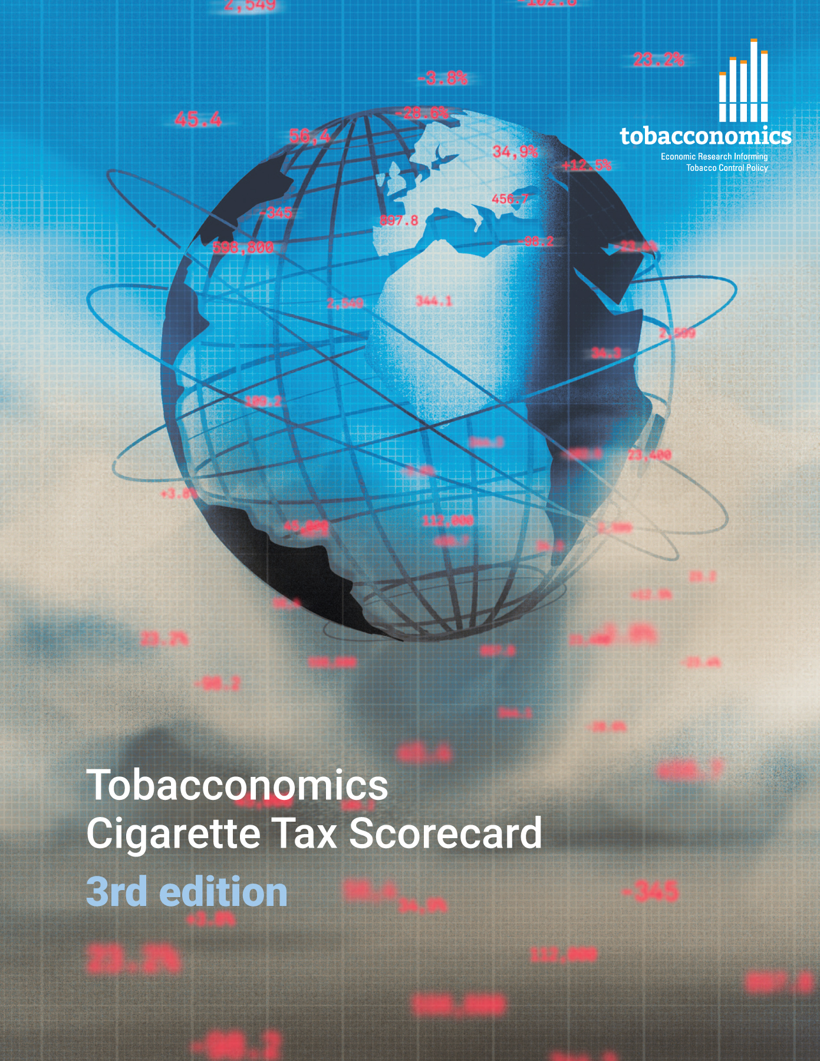
Cigarette tax policies in Paraguay, 2022
4 key tax components were assessed using a 5-point scale, with the overall score reflecting an average of Paraguay’s component scores.
The scores reflect the current strengths and opportunities in Paraguay to further increase tax revenue and improve health.
OPPORTUNITY
for improvement
www.tobacconomics.org | @tobacconomics | Tobacconomics Cigarette Tax Scorecard (3rd edition)

Slide 2
How does Paraguay compare to other countries?
Paraguay’s overall score in 2022 is compared to the average overall scores in its income group, region, the world, and top performers.
www.tobacconomics.org | @tobacconomics | Tobacconomics Cigarette Tax Scorecard (3rd edition)

Slide 3
How does Paraguay compare to other countries?
The components of Paraguay’s score in 2022 are compared to component scores in the region, income group, world, and top performers.
PRICE, AFFORDABILITY CHANGE, AND TAX SHARE
require the most improvement.
www.tobacconomics.org | @tobacconomics | Tobacconomics Cigarette Tax Scorecard (3rd edition)

Slide 4
Paraguay’s cigarette tax policies over time
Paraguay’s overall score stayed constant over time, receiving the lowest score in cigarette price, affordability change, and tax share.
www.tobacconomics.org | @tobacconomics | Tobacconomics Cigarette Tax Scorecard (3rd edition)

