Slide 1
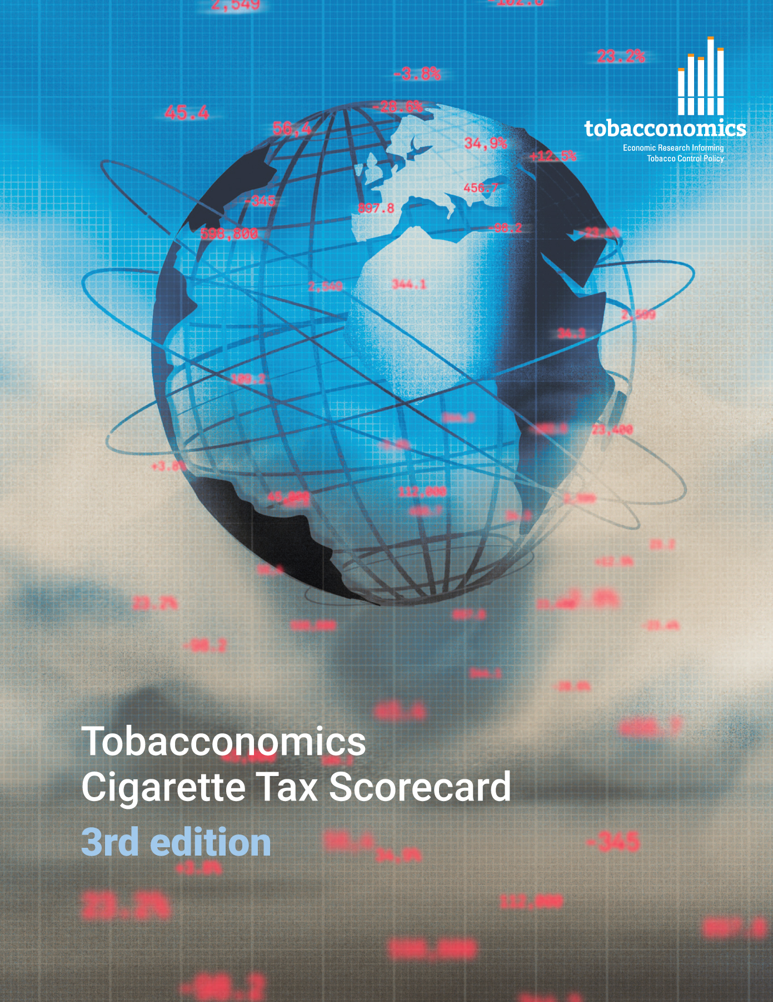
Cigarette tax policies in Pakistan, 2022
4 key tax components were assessed using a 5-point scale, with the overall score reflecting an average of Pakistan’s component scores.
The scores reflect the current strengths and opportunities in Pakistan to further increase tax revenue and improve health.
OPPORTUNITY
for improvement
www.tobacconomics.org | @tobacconomics | Tobacconomics Cigarette Tax Scorecard (3rd edition)

Slide 2
How does Pakistan compare to other countries?
Pakistan’s overall score in 2022 is compared to the average overall scores in its income group, region, the world, and top performers.
www.tobacconomics.org | @tobacconomics | Tobacconomics Cigarette Tax Scorecard (3rd edition)

Slide 3
How does Pakistan compare to other countries?
The components of Pakistan’s score in 2022 are compared to component scores in the region, income group, world, and top performers.
AFFORDABILITY CHANGE
requires the most improvement.
www.tobacconomics.org | @tobacconomics | Tobacconomics Cigarette Tax Scorecard (3rd edition)

Slide 4
Pakistan’s cigarette tax policies over time
Pakistan’s overall score fluctuated slightly between 2014 and 2022 due to changes in cigarette prices and the tax share of price.
www.tobacconomics.org | @tobacconomics | Tobacconomics Cigarette Tax Scorecard (3rd edition)

