Slide 1
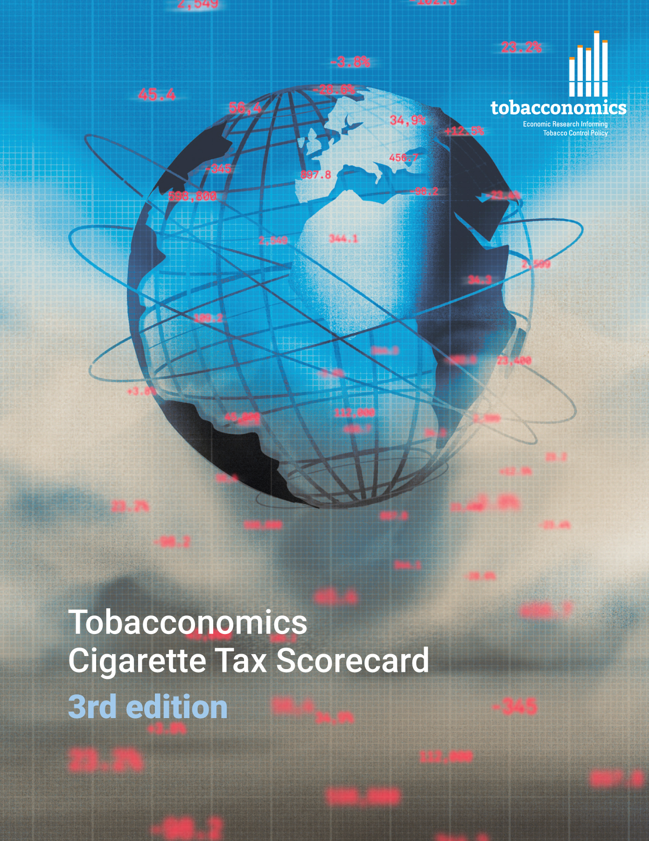
Cigarette tax policies in Mexico, 2022
4 key tax components were assessed using a 5-point scale, with the overall score reflecting an average of Mexico’s component scores.
The scores reflect the current strengths and opportunities in Mexico to further increase tax revenue and improve health.
OPPORTUNITY
for improvement
www.tobacconomics.org | @tobacconomics | Tobacconomics Cigarette Tax Scorecard (3rd edition)

Slide 2
How does Mexico compare to other countries?
Mexico’s overall score in 2022 is compared to the average overall scores in its income group, region, the world, and top performers.
www.tobacconomics.org | @tobacconomics | Tobacconomics Cigarette Tax Scorecard (3rd edition)

Slide 3
How does Mexico compare to other countries?
The components of Mexico’s score in 2022 are compared to component scores in the region, income group, world, and top performers.
AFFORDABILITY CHANGE
requires the most improvement.
www.tobacconomics.org | @tobacconomics | Tobacconomics Cigarette Tax Scorecard (3rd edition)

Slide 4
Mexico’s cigarette tax policies over time
Mexico’s overall score dropped from 2014 to 2016 due to a failure to reduce affordability over time, but increased slightly in 2020 due to an increase in cigarette prices.
www.tobacconomics.org | @tobacconomics | Tobacconomics Cigarette Tax Scorecard (3rd edition)

