Slide 1
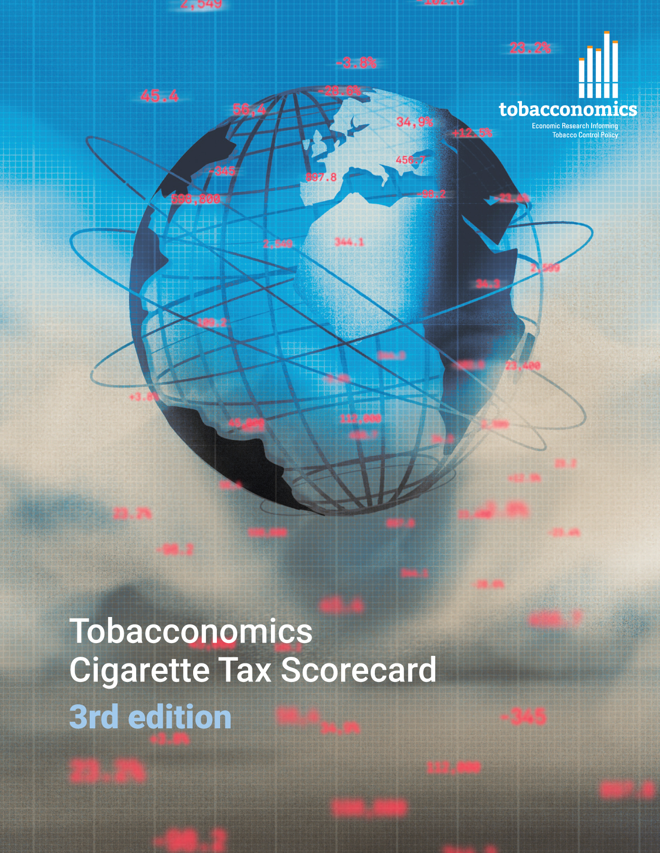
Cigarette tax policies in Indonesia, 2022
4 key tax components were assessed using a 5-point scale, with the overall score reflecting an average of Indonesia’s component scores.
The scores reflect the current strengths and opportunities in Indonesia to further increase tax revenue and improve health.
OPPORTUNITY
for improvement
www.tobacconomics.org | @tobacconomics | Tobacconomics Cigarette Tax Scorecard (3rd edition)

Slide 2
How does Indonesia compare to other countries?
Indonesia’s overall score in 2022 is compared to the average overall scores in its income group, region, the world, and top performers.
www.tobacconomics.org | @tobacconomics | Tobacconomics Cigarette Tax Scorecard (3rd edition)

Slide 3
How does Indonesia compare to other countries?
The components of Indonesia’s score in 2022 are compared to component scores in the region, income group, world, and top performers.
AFFORDABILITY CHANGE
requires the most improvement.
www.tobacconomics.org | @tobacconomics | Tobacconomics Cigarette Tax Scorecard (3rd edition)

Slide 4
Indonesia’s cigarette tax policies over time
Indonesia’s overall score dropped somewhat from 2020 to 2022, largely due to a failure to reduce the affordability of cigarettes over time although tax share of price increased in that time.
www.tobacconomics.org | @tobacconomics | Tobacconomics Cigarette Tax Scorecard (3rd edition)

