Slide 1
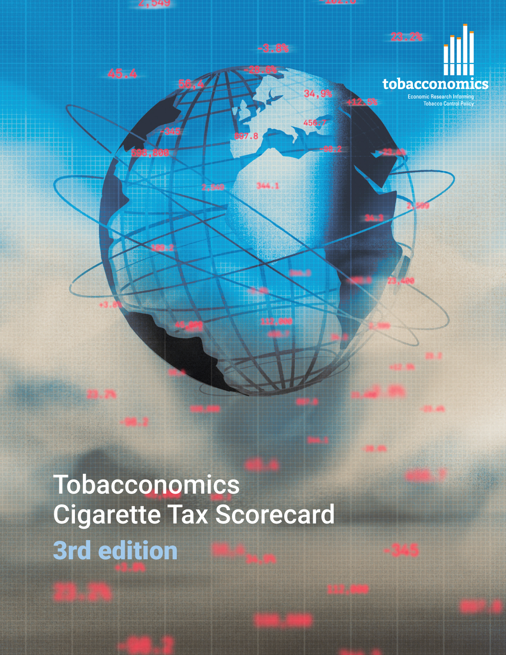
Cigarette tax policies in Brazil, 2022
4 key tax components were assessed using a 5-point scale, with the overall score reflecting an average of Brazil’s component scores.
The scores reflect the current strengths and opportunities in Brazil to further increase tax revenue and improve health.
OPPORTUNITY
for improvement
www.tobacconomics.org | @tobacconomics | Tobacconomics Cigarette Tax Scorecard (3rd edition)

Slide 2
How does Brazil compare to other countries?
Brazil’s overall score in 2022 is compared to the average overall scores in its income group, region, the world, and top performers.
www.tobacconomics.org | @tobacconomics | Tobacconomics Cigarette Tax Scorecard (3rd edition)

Slide 3
How does Brazil compare to other countries?
The components of Brazil’s score in 2022 are compared to component scores in the region, income group, world, and top performers.
CIGARETTE PRICE & AFFORDABILITY CHANGE
require the most improvement.
www.tobacconomics.org | @tobacconomics | Tobacconomics Cigarette Tax Scorecard (3rd edition)

Slide 4
Brazil’s cigarette tax policies over time
Brazil’s overall score dropped gradually from 2016 to 2022, largely due to a failure to decrease affordability of cigarettes over time.
www.tobacconomics.org | @tobacconomics | Tobacconomics Cigarette Tax Scorecard (3rd edition)

