Slide 1
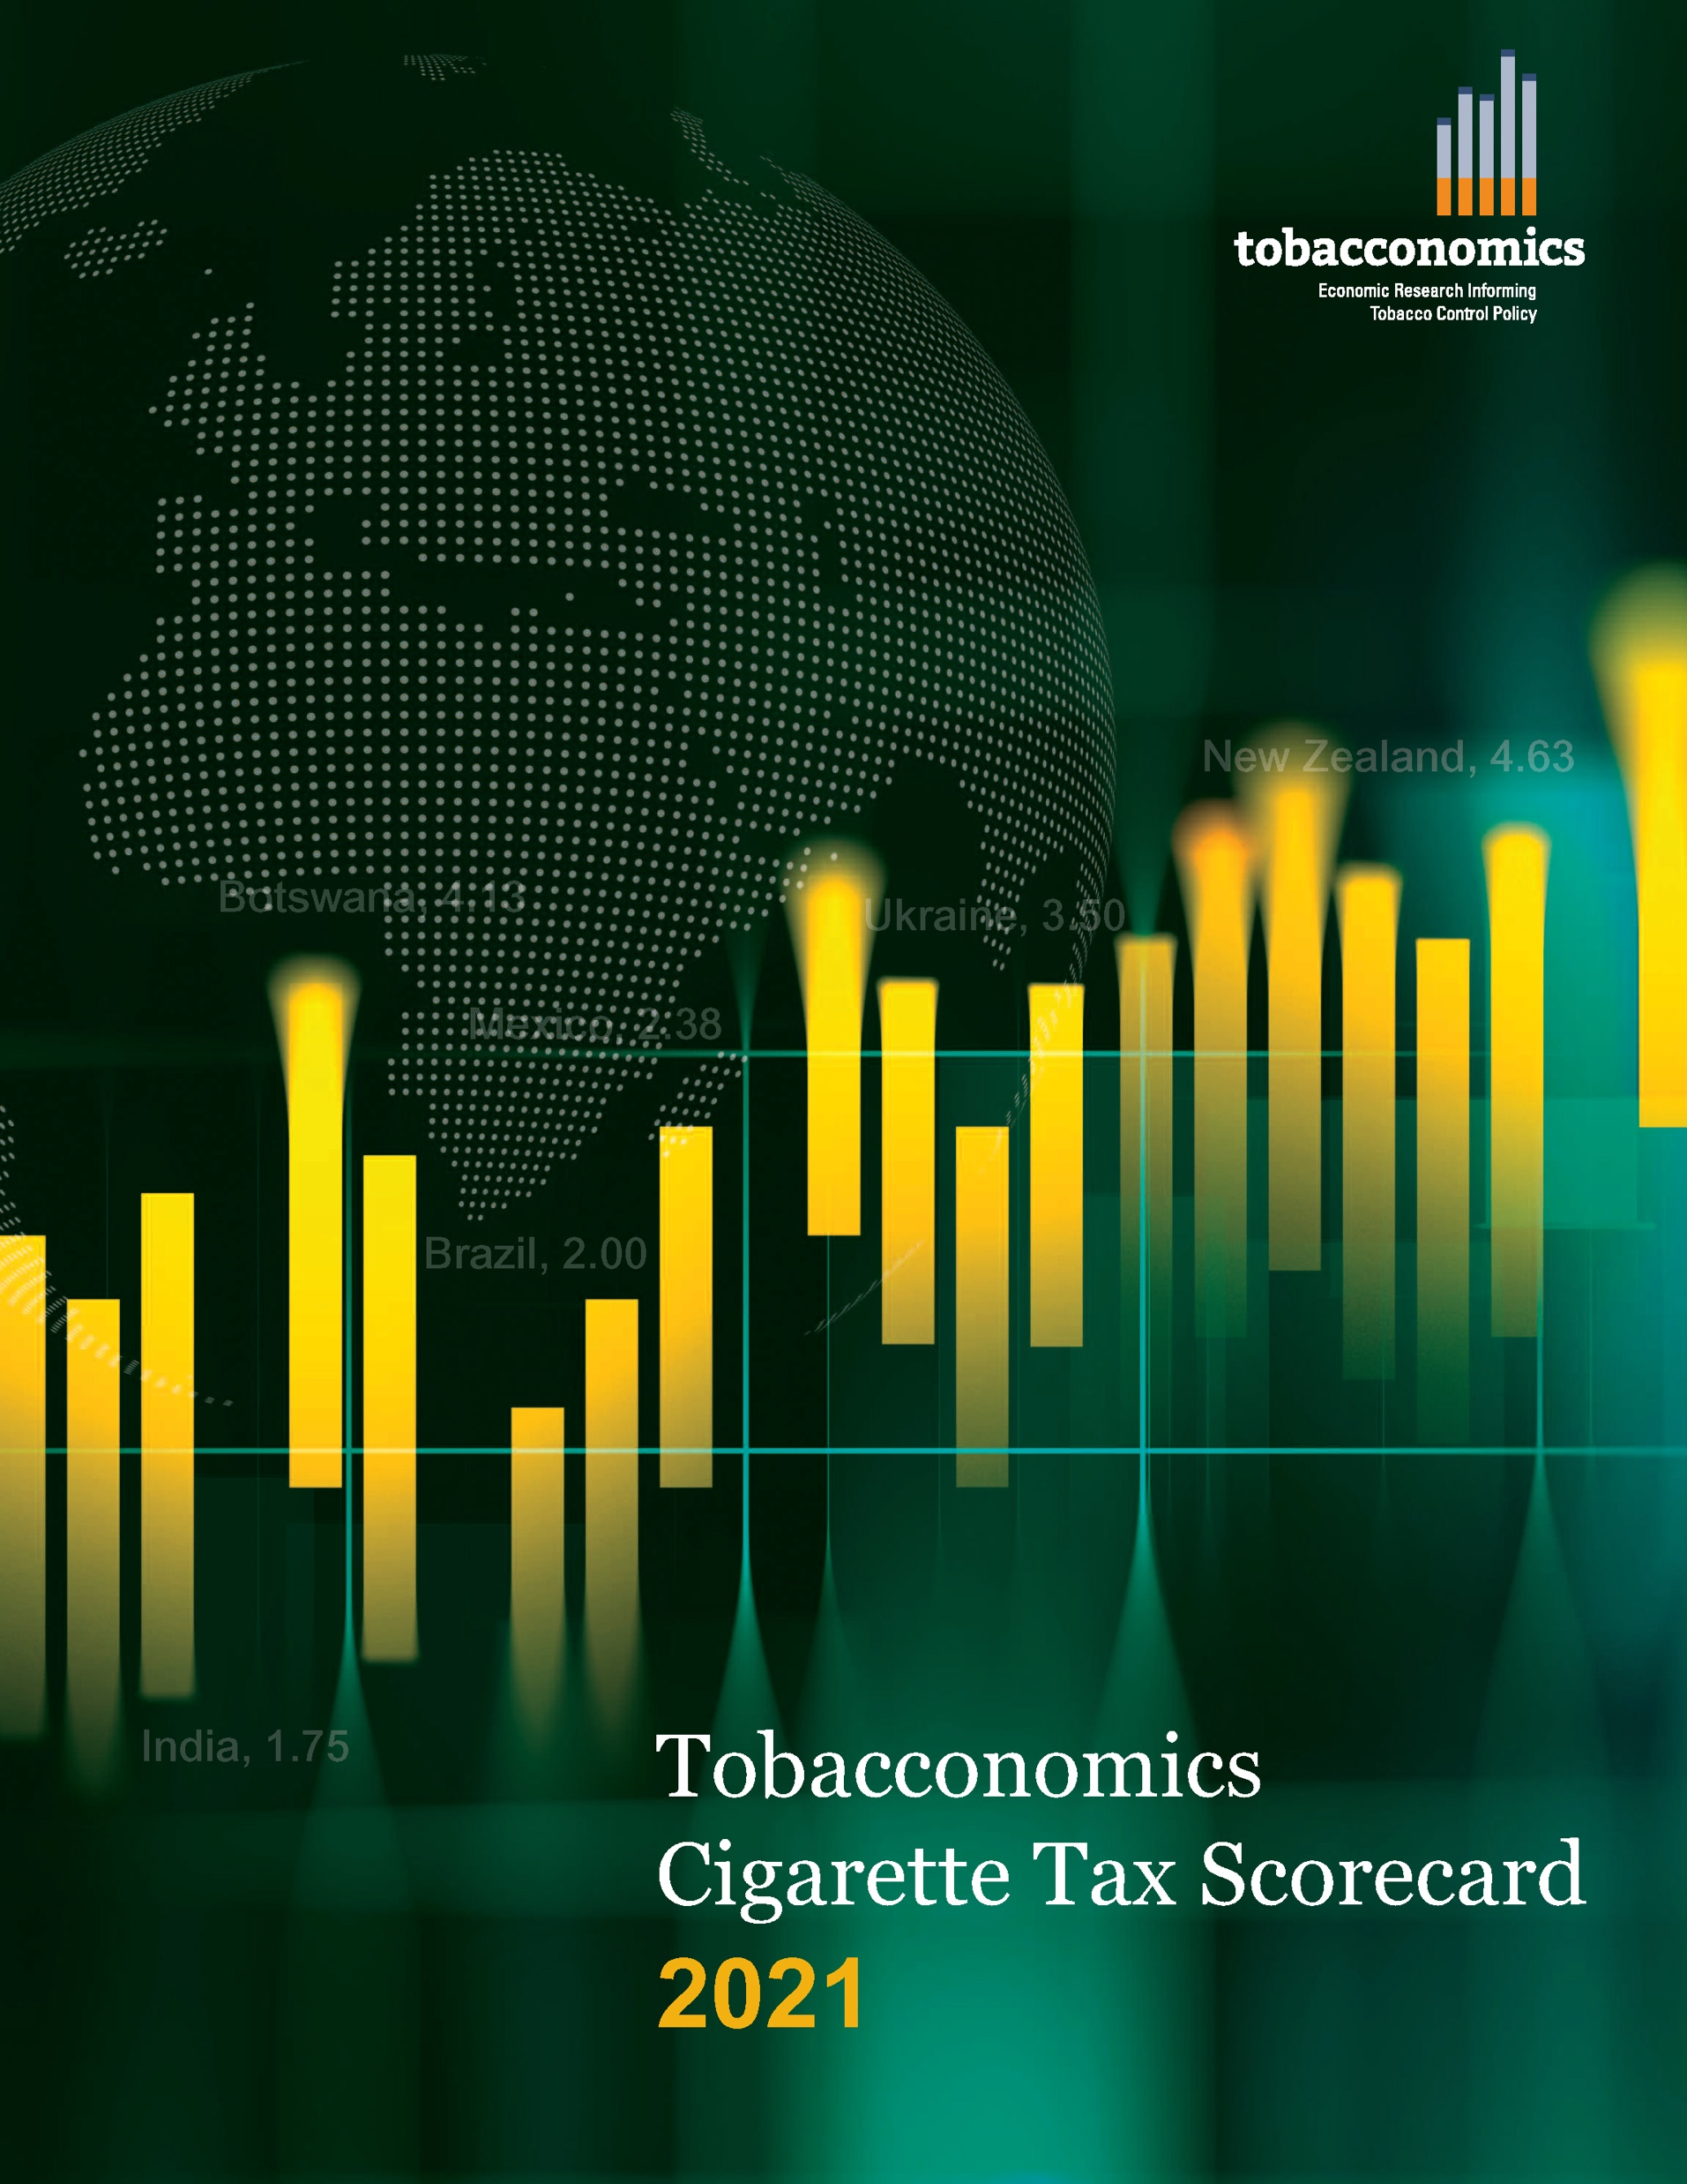
Cigarette tax policies in Indonesia, 2020
4 key tax components were assessed using a 5-point scale, with the overall score reflecting an average of Indonesia’s component scores.
The scores reflect the current strengths and opportunities in Indonesia to further increase tax revenue and improve health.
OPPORTUNITY
for improvement
www.tobacconomics.org | @tobacconomics | Tobacconomics Cigarette Tax Scorecard

Slide 2
How does Indonesia compare to other countries?
Indonesia’s overall score in 2020 is compared to the average overall scores in its region, income group, the world, and top performers.
www.tobacconomics.org | @tobacconomics | Tobacconomics Cigarette Tax Scorecard

Slide 3
How does Indonesia compare to other countries?
The components of Indonesia’s score in 2020 are compared to component scores in the region, income group, world, and top performers.
TAX STRUCTURE
requires the most improvement.
www.tobacconomics.org | @tobacconomics | Tobacconomics Cigarette Tax Scorecard

Slide 4
Indonesia’s cigarette tax policies over time
Indonesia’s overall score increased between 2018 and 2020, due to a decrease in the affordability of cigarettes.
www.tobacconomics.org | @tobacconomics | Tobacconomics Cigarette Tax Scorecard

