Slide 1
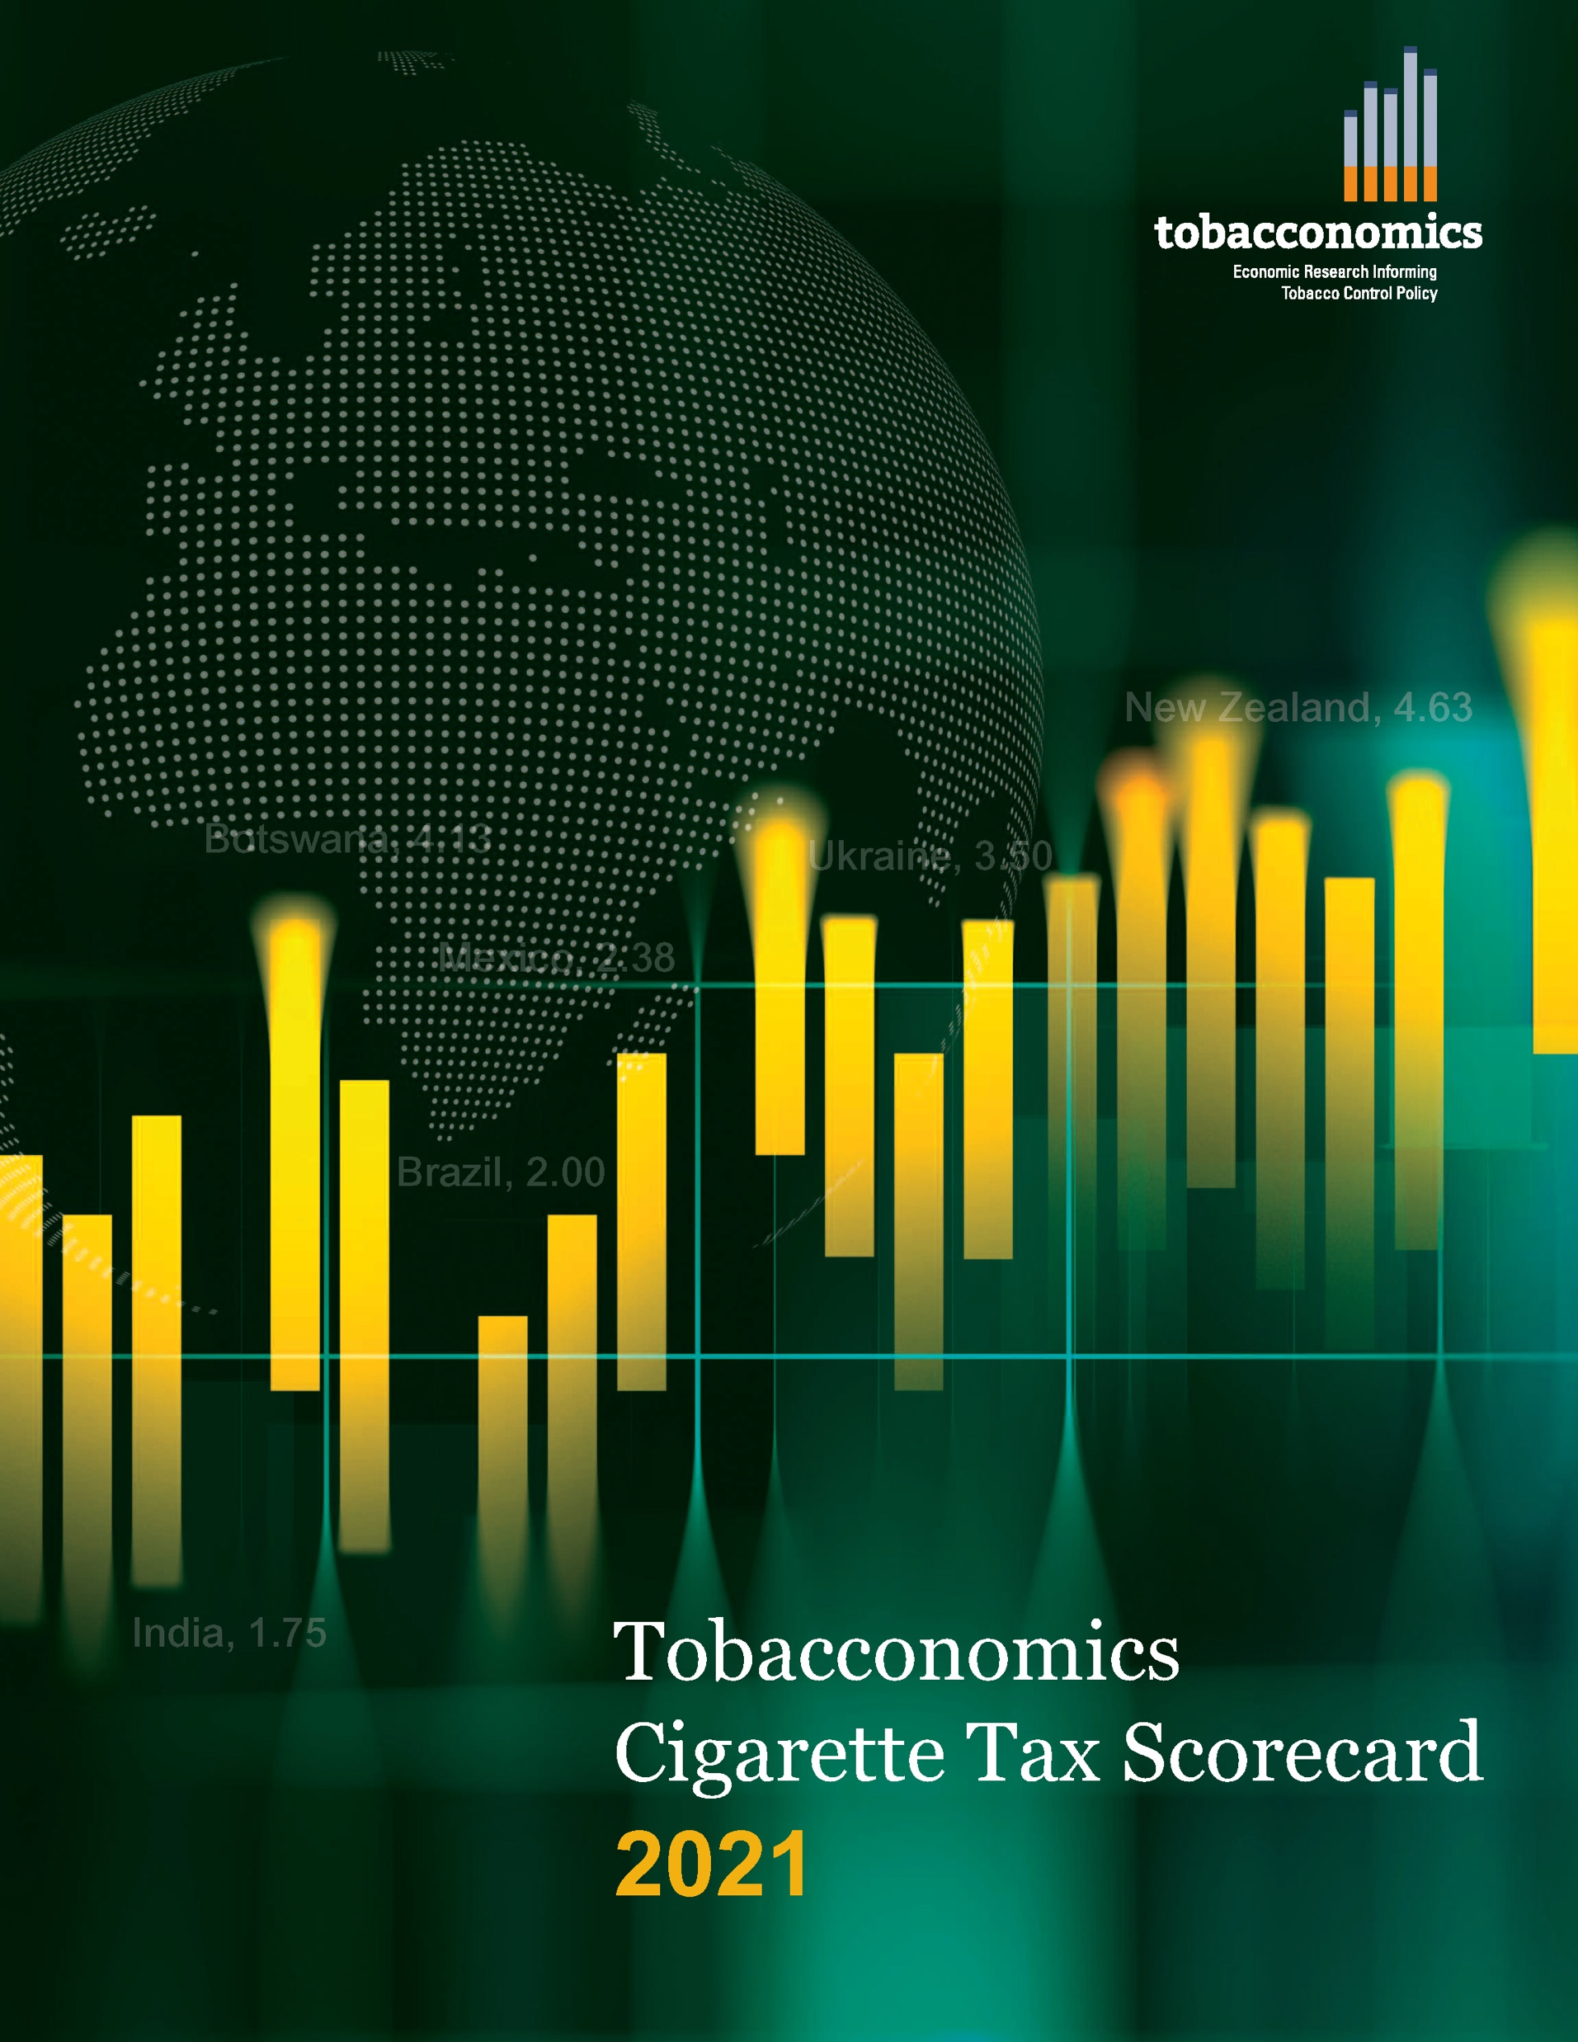
Cigarette tax policies in Burkina Faso, 2020
4 key tax components were assessed using a 5-point scale, with the overall score reflecting an average of Burkina Faso’s component scores.
The scores reflect the current strengths and opportunities in Burkina Faso to further increase tax revenue and improve health.
OPPORTUNITY
for improvement
www.tobacconomics.org | @tobacconomics | Tobacconomics Cigarette Tax Scorecard

Slide 2
How does Burkina Faso compare to other countries?
Burkina Faso’s overall score in 2020 is compared to the average overall scores in its region, income group, the world, and top performers.
www.tobacconomics.org | @tobacconomics | Tobacconomics Cigarette Tax Scorecard

Slide 3
How does Burkina Faso compare to other countries?
The components of Burkina Faso’s score in 2020 are compared to component scores in the region, income group, world, and top performers.
CIGARETTE PRICE AND TAX SHARE require the most improvement.
www.tobacconomics.org | @tobacconomics | Tobacconomics Cigarette Tax Scorecard

Slide 4
Burkina Faso’s cigarette tax policies over time
Burkina Faso’s overall score remained constant from 2018 to 2020.
www.tobacconomics.org | @tobacconomics | Tobacconomics Cigarette Tax Scorecard

